Slide 1
Hardware

Slide 2
Component
MCU : STM32F103CBT6
MEMS Sensor : MPU6050(3axis Gyroscope and 3axis Accelerometer)
2.4GHz RF : NRF24l01+
Motor Driver : SI2310 MOS Tube
Battery Charger IC : TP4056
LDO : SPX3819
Ultrasound Module : US100
Motor : 720 Hollow Cup Motor
Propeller : 55mm Propeller (Positive and Negative)
Battery : 3.7V 700mah LiPo Battery

Slide 3
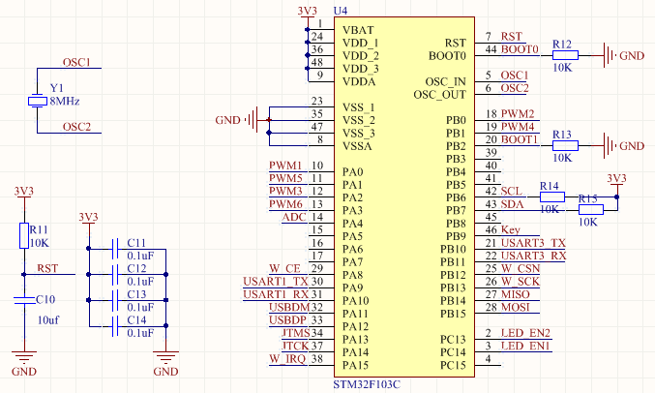
System of STM32

Slide 4
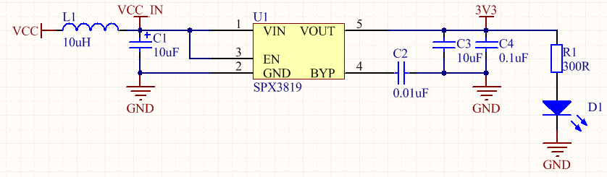
Power Management Unit（PMU）

Slide 5
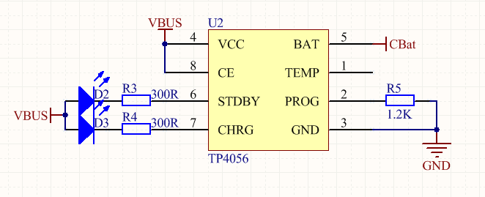
Charge Management

Slide 6
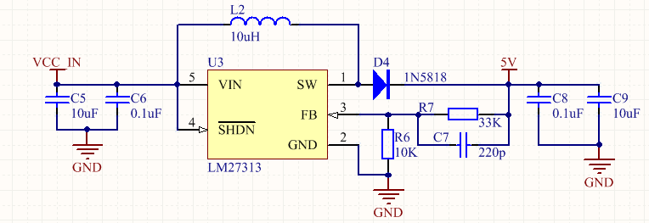
Step-Up（Boost）

Slide 7
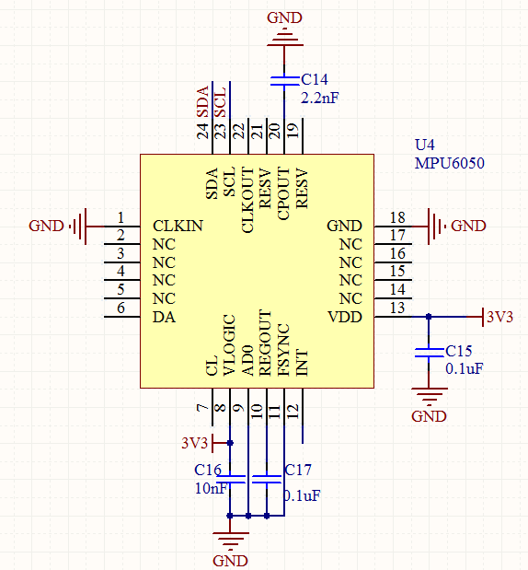
MPU6050

Slide 8
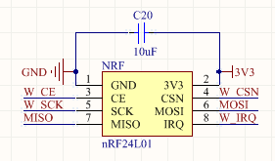
NRF24l01+

Slide 9
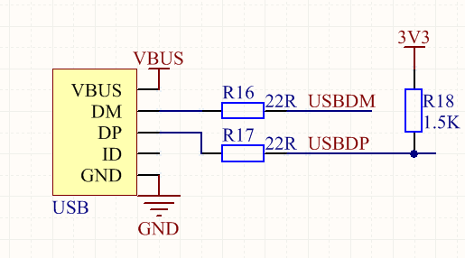
USB

Slide 10
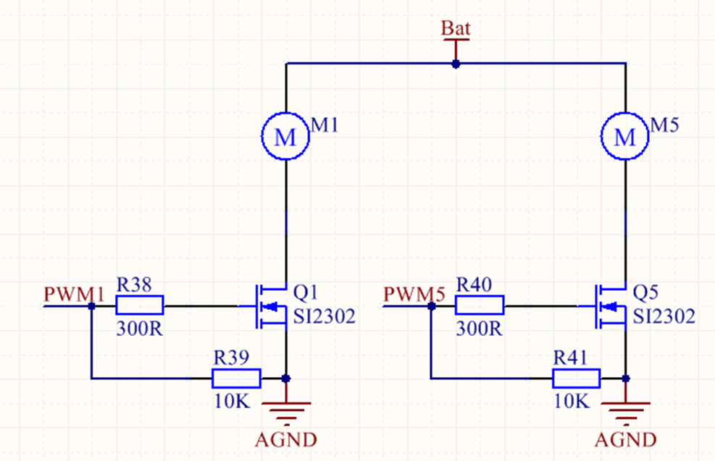
Motor driver

Slide 11
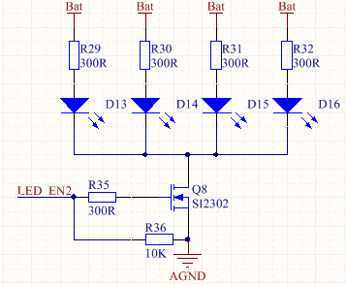
LED

